Slide 1


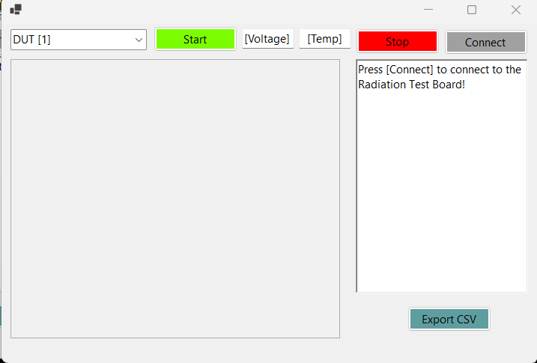
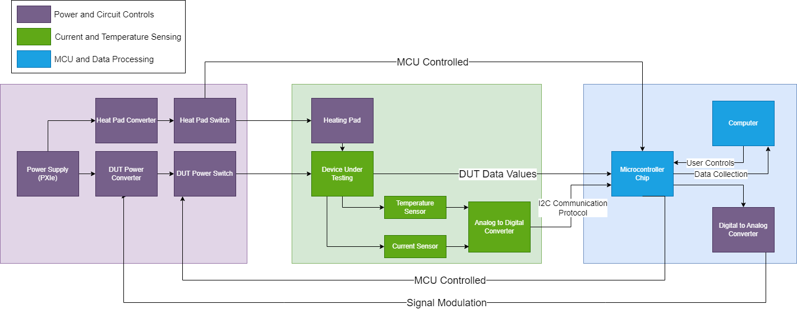
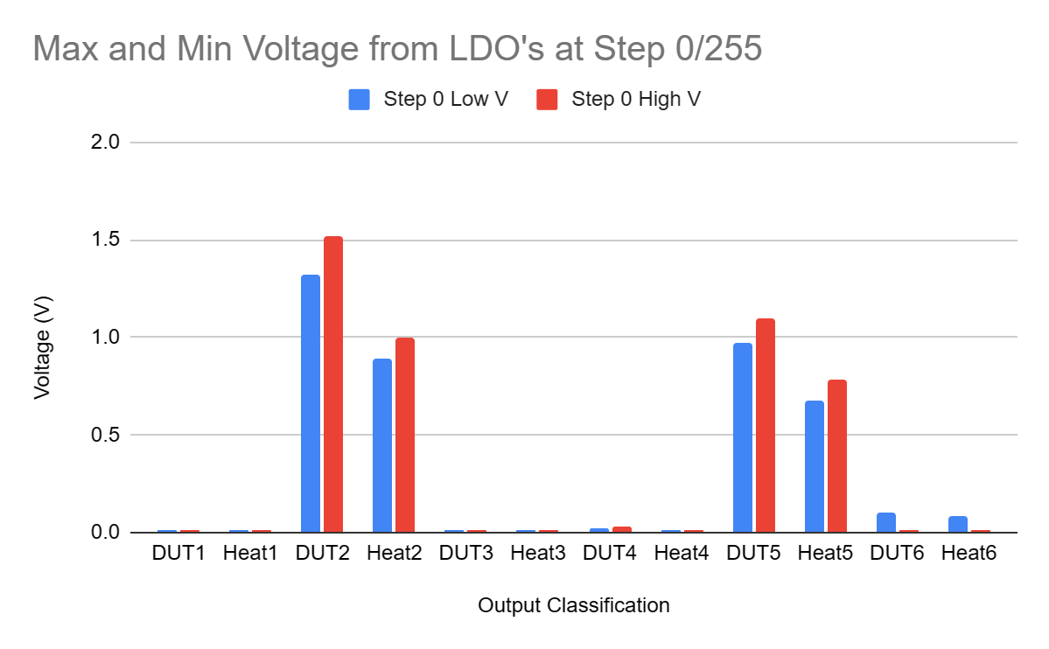
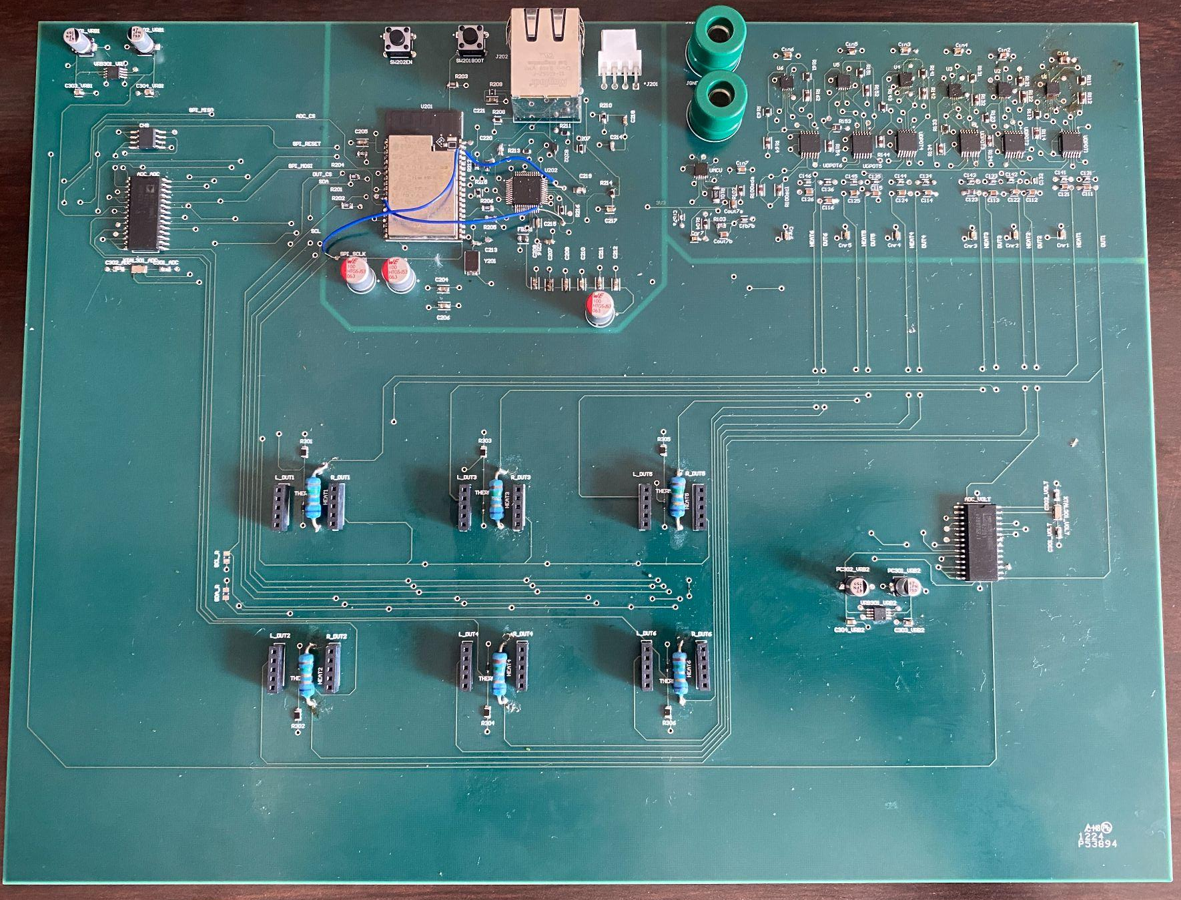
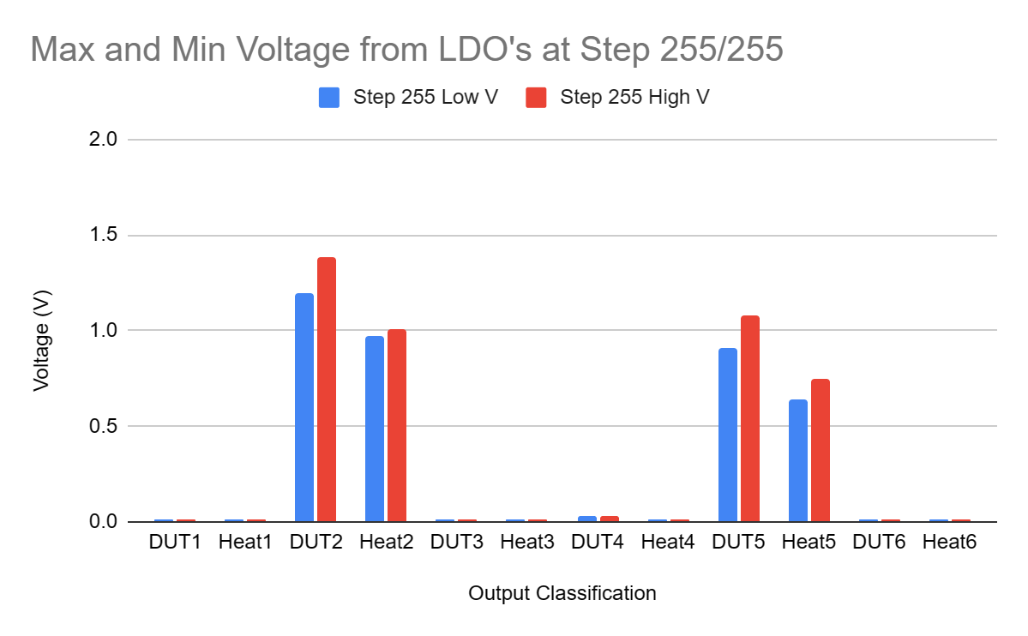
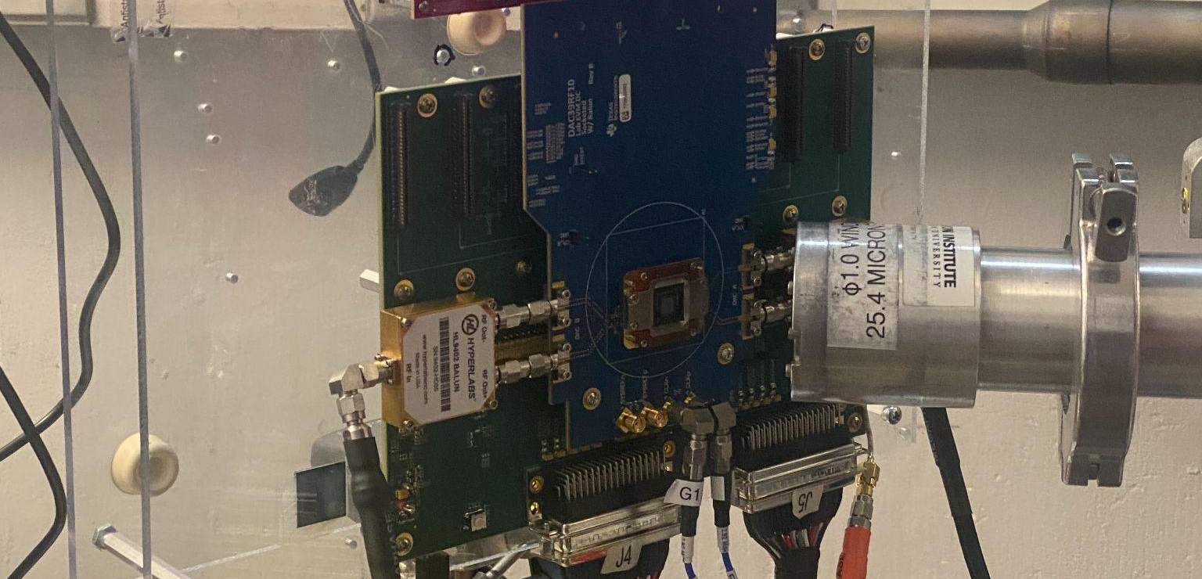
EPS Booth: 347
Radiation Test Board
Aaron Ganus, Stanley Lee, Kenneth Chen
Faculty Mentor: Stavros Kalafatis
Instructor: John Lusher
Problem Definition
The commercial space travel industry has been developing rapidly, increasing the demand for space grade electrical components from manufacturers such as Texas Instruments (TI). Currently, each device under testing (DUT) can only be tested one at a time, with a long downtime between for switching DUTs. The DUTs assigned to test are TI temperature sensors. Our task was to create an efficient test system capable of testing multiple devices with minimal downtime.
Engineering Analysis
Our project had unique challenges and opportunities due to our sponsor’s request.
Our sponsor requested all subsystems to be on one PCB, making debugging more difficult as only one team member could do so at a time.
Due to the subsystem’s being combined, if one subsystem did not perform as expected, the other subsystems were more difficult to test.
Due to the multiple custom voltage levels specified by project requirements, a digital potentiometer presented itself as a suitable option. This is because the digital potentiometers have 256 taps which should enable a voltage range of 2.45 V to the input voltage, which is 6 V.
Impact
The current testing procedure at the TAMU Cyclotron Institute consists of placing the test board on the mobile test stage. After the board is secured, the engineer moves to the monitoring room, specifies test parameters, and then remotely operates the test stage, moving the DUT into the path of the radiation beam. Then the engineer gathers data, repeating the previous steps for every DUT to be tested along with replacing the DUT by either using a coupon board or soldering another DUT. The downtime between tests is tedious and takes up a significant amount of time. Our Radiation Test Board can hold up to 6 DUTs, reducing the downtime to merely selecting which DUT is to be tested using our application, and then moving the new DUT into the path of the beam via the test stage. It costs thousands of dollar per hour to test at the Cyclotron institute, and our project enables more tests to be done every hour, saving Texas Instruments both time and money.
Figure 5. PC Application GUI
Methodology
Our project was broken into 3 different subsystems: Power Controls, Microcontroller & Data Processing and Current & Temperature Sensing.
Power Controls
Developed an adjustable Buck-Boost Converter using the LTC3780
Designed a FET switching configuration to be coupled to the Buck-Boost Converter
Developed a 6 volt to adjustable levels via low-dropout (linear) voltage output regulators and digital potentiometers
Microcontroller & Data Processing
PC Application to view data and control system
PCB w/ Microcontroller and peripherals
I2C and SPI protocols to receive sensor data and direct Power Controls
Current & Temperature Sensing
Designed socket where the coupon board will insert in with a heating element and on board temperature sensor
On board ADC(AD7718) to convert temperature sensor data to digital and any additional analog signals using SPI
Designed coupon board to test temperature sensor TMP117
Outcomes
The power controls subsystem successfully provided the requisite separate voltages for the other two subsystems. The MCU can write to the digital potentiometer and the ADC. The MCU can read from the ADC and the values from the coupon boards using SPI and I2C, respectively, however, it is inconsistent. In addition, the digital potentiometer outputs were also inconsistent and modifications were required.
Subsystem Interaction Diagram
References
Baumann, R., &amp; Kruckmeyer, K. (2020). Radiation Handbook for Electronics. Texas Instruments.
“TPL0102-100.” TPL0102-100 Data Sheet, Product Information and Support | TI.Com, www.ti.com/product/TPL0102-100.
ESP32-S2-Wrover_esp32-S2-Wrover-I_datasheet_en.PDF, www.espressif.com/sites/default/files/documentation/esp32-s2-wrover_esp32-s2-wrover-i_datasheet_en.pdf. Accessed 23 Apr. 2024.
E. G. Stassinopoulos and J. P. Raymond, “The space radiation environment for electronics,” Proc. of the IEEE 76(11), Nov. 1988, pp. 1423-1442.
Vigreux, C. (2016). (rep.). SINGLE EVENT LATCH-UP TEST REPORT ADCLK925S. Analog Devices.
G. Bruguier and J-M. Palau, “Single Particle-Induced Latchup,”IEEE Trans. Nucl. Sci. 43(2), April 1996, pp. 522-532.
Figure 2. Subsystem Diagram
Figure 6. LDO Voltage Ranges at Step 0/255
Acknowledgements
Thank you to Dr. Lusher, Prof. Kalafatis, Meredith McKean, and Texas Instruments for their guidance and support throughout the project
Figure 1. TI Testing Board before Cyclotron Testing
Figure 3. Integrated Board
Figure 7. LDO Voltage Ranges at Step 255/255

